Slide 1

.
.
BY –
KARTIKEYA TIWARI AND PRIYANSHU JAISWAL
CSIT 1-B

Slide 2
Overview of our website-:
About us
Our Menu
Table Reservation process
Our past customer’s review

Slide 3


Slide 4
HTML TAGS USED IN MAKING OUR WEBSITE:-

Slide 5

.
For Basic Structure
<html>: Defines the root of the HTML document.
<head>: Contains meta-information about the webpage (e.g., title, styles, scripts).
<title>: Sets the title of the webpage displayed in the browser tab.
<body>: Contains the content visible to the user

Slide 6
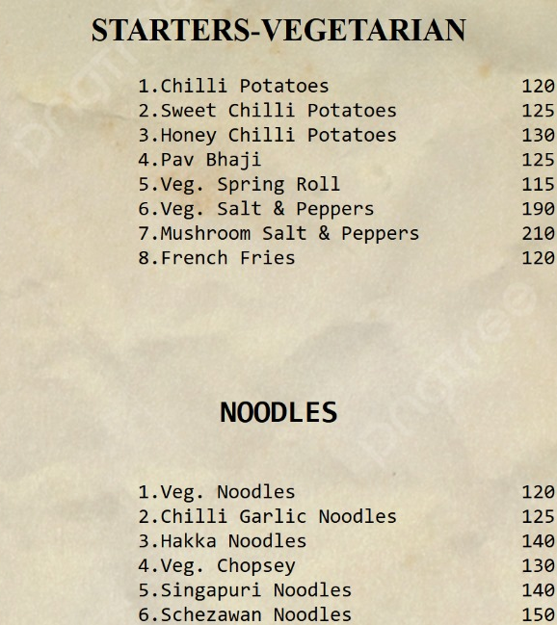
For Tables and Menus
<table>: Defines tables for displaying menus or pricing.
<tr>: Table rows.
<td>: Table cells.
<th>: Table header cells.
<thead> / <tbody> / <tfoot>: Groups table sections.

Slide 7
For Interactive Features
<button>: Defines buttons for user actions (e.g., "Reserve a Table").
<form>: Collects user input (e.g., for reservations or contact forms).
<input>: Defines input fields (e.g., text, email, date).
<textarea>: Allows multi-line text input.
<label>: Labels for form elements.
<select> / <option>: Dropdown menus.
<fieldset> / <legend>: Group related form elements.
For Navigation
<nav>: Defines navigation menus.
<ul> / <ol>: Create unordered or ordered lists for navigation links or features.
<li>: List items (used inside <ul> or <ol>).
<a>: Links to other pages or sections.

Slide 8
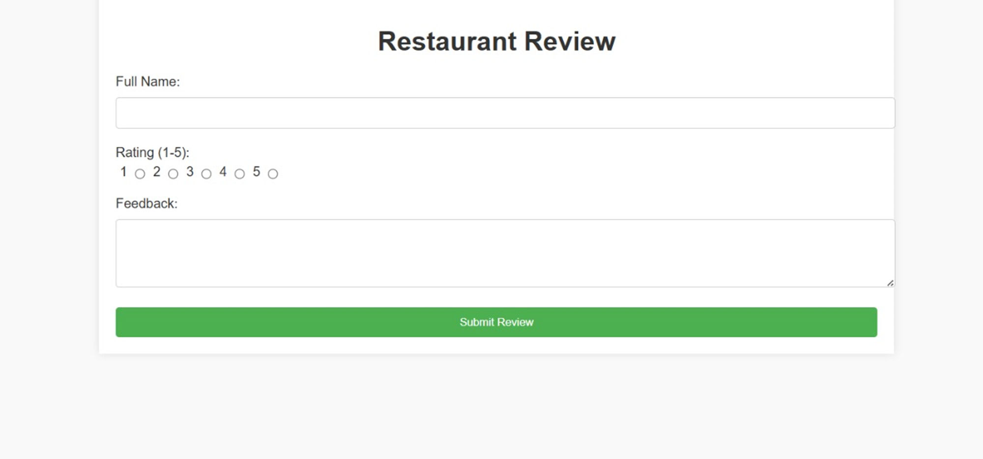
For Form Fields:
Name Input (<input type="text">) for the reviewer's name.
Rating Dropdown (<select>) to select a rating from 1 to 5.
Review Text Area (<textarea>) for the review text.
Submit Button (<button>) to send the review.
Reviews Display:
Pre-styled reviews are displayed using the <div> tag with classes like name, rating, and comment.

Slide 9

For Layout and Structure
<header>: Contains introductory content or navigation links.
<footer>: Contains footer information (e.g., address, hours, copyright).
<article>: Represents self-contained content (e.g., a blog post).
<aside>: Defines sidebars or secondary information.
<div>: A general-purpose container for layout.
.
This Photo by Unknown Author is licensed under CC BY-NC-ND

Slide 10

For Headers and Text
<h1> to <h6>: Define headings for titles and sections (e.g., "Welcome to Our Restaurant").
<p>: Defines paragraphs for descriptive text (e.g., about the restaurant).
<span>: Used to style parts of the text inline.
<strong>: Highlights important text (bold).
<em>: Emphasizes text (italic).
.

Slide 11
THANKYOU FOR VISITING OUR WEBSITE !
.

